Slide 1
Bivariate Probability Distribution -- for discrete random variables (Chapter 5, section 5.1-5.2-5.3)
Lecture 20

Slide 2
Recap
Beta Distribution last time (Lots of integration)
Next class: double-integration
Calculus review material from beg of course
Any interest in an extra office hour just to review integration/double-integration?
Before our next class?
Choices:Today at 5 pm, Tuesday at 9 am or 5 pm? Wednesday at 12?
Homework #8 due Thursday 4/4
Exam #2 Thursday 4/11

Slide 3
Game of tossing a pair of fair dice
Game: three students, A, B and C, toss two fair 6-sided dice and observe the numbers (or the number of dots) on the top of dice.
Rule: A wins if both dice are odd numbers
B wins if one die is an odd number and one die is an even number
C wins if the 1st die is odd number & the 2nd die is an even number
Questions:
Which player do you want to be?
Or what is the probability of each
player win in the above rule?
 | 1 | 2 | 3 | 4 | 5 | 6
1
2
3
4
5
6
Answer:
P(A) = ½ * ½ = ¼
P(B) = ½ * ½ * 2 = ½
P(C)= ½ * ½ = ¼

Slide 4
Review
Probability distribution of discrete random variables: 2 properties
Three ways of expressing the probability distribution of discrete random variables:
CDF of a discrete random variable :
(1) definition, F(y)=?
(2) three properties,
(3) P(Y>3)=?

Slide 5
Bivariate Probability Distribution -- for discrete random variables (Section 5.2)
Example of tossing two fair dice (Reading on Page 224). :
Let Y₁ be the number (or number of dots) appearing on die 1
Let Y₂ be the number (or number of dots) appearing on die 2
Questions
1. What is the sample space S? (Or S=?)
2. What is the probability of observing each pair (y₁, y₂), where y₁, y₂ = 1, 2, 3, 4, 5, 6?

Slide 6
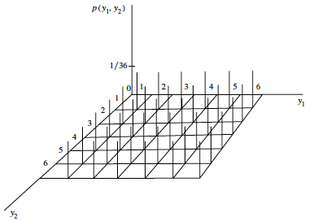
Example of tossing a pair of dice
1. Sample Space S:
Y₂
 | 1 | 2 | 3 | 4 | 5 | 6
1 | (1,1) | (1,2) | (1,3) | (1,4) | (1,5) | (1,6)
2 | (2,1) | (2,2) | (2,3) | (2,4) | (2,5) | (2,6)
3 | (3,1) | (3,2) | (3,3) | (3,4) | (3,5) | (3,6)
4 | (4,1) | (4,2) | (4,3) | (4,4) | (4,5) | (4,6)
5 | (5,1) | (5,2) | (5,3) | (5,4) | (5,5) | (5,6)
6 | (6,1) | (6,2) | (6,3) | (6,4) | (6,5) | (6,6)
Y₁
2. What is the probability of observing each pair (y₁, y₂)? (Answer: 1/36)

Slide 7
Example: Joint probability function for Y₁ and Y₂
DEFINITION 5.1 (Page 225) Let Y₁ and Y₂ be discrete random variables. The joint (or bivariate) probability function for Y₁ and Y₂ is given by
p(y₁, y₂) = P(Y₁ = y₁, Y₂ = y₂), −∞ < y₁ < ∞, −∞ < y₂ < ∞.
Y₂
 | 1 | 3
2 | 1/2 | 1/6
9 | 1/6 | 1/6
Y₁

Slide 8
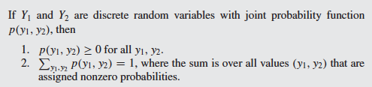
Theorem 5.1 (Page 225) – It is for discrete random variables
What is ?
Reflection: How is the above theorem related to the probability
distribution of univariate discrete random variable?
8

Slide 9


The CDF for bivariate probability distribution
Definition 5.2 ( page 226)

Slide 10
Example of tossing a pair of dice
Sample Space S:
Y₂
 | 1 | 2 | 3 | 4 | 5 | 6
1 | (1,1) | (1,2) | (1,3) | (1,4) | (1,5) | (1,6)
2 | (2,1) | (2,2) | (2,3) | (2,4) | (2,5) | (2,6)
3 | (3,1) | (3,2) | (3,3) | (3,4) | (3,5) | (3,6)
4 | (4,1) | (4,2) | (4,3) | (4,4) | (4,5) | (4,6)
5 | (5,1) | (5,2) | (5,3) | (5,4) | (5,5) | (5,6)
6 | (6,1) | (6,2) | (6,3) | (6,4) | (6,5) | (6,6)
Y₁
1. F(3, 3)= P(Y₁ ≤ 3, Y₂ ≤ 3) =?
Answer: P(Y₁ ≤3 ,Y₂ ≤ 3) = 9/36 = 1/4
2. What is the probability of Y₁> 3 and Y₂ > 4 ?
Answer: P(Y₁ >3, Y₂ > 4)= 6/36 = 1/6
10

Slide 11
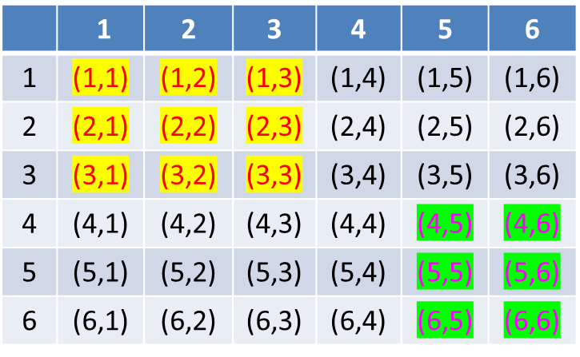
Example of tossing a pair of dice
Question: For the univariate case, P(Y>3)= 1-P(Y≤3) = 1-F(3). For bivariate case, is it true P(Y₁ >3, Y₂ > 4) = 1- F(3, 4)??
Answer: P(Y₁ >3, Y₂ > 4) ≠ 1- F(3, 4), where F(3, 4)= 12/36=1/3
{But P(Y₁ >3) + P(Y₂ > 4) - P(Y₁ >3, Y₂ > 4) =2/3}

Slide 12

Warm up example-Joint/Marginal/Conditional
Example: Suppose we have an experiment in X and Y, where X takes on the values 0,1,2 and Y takes on the values 0,1. The joint distribution P(X=x,Y=y) is the set of all possibilities
The probabilities of these events are given to us from prior information below. How do we reduce this to a problem only in X? Only in Y?
$$\left\{\begin{matrix}00 \\ 01 \\ 10 \\ 11 \\ 20 \\ 21\end{matrix}\right.$$
 |  | Y
 |  | 0 | 1
 | 0 | 0 | 0.2
X | 1 | 0.1 | 0.1
 | 2 | 0.2 | 0.4

Slide 13
Discrete Joint/Marginal
 |  | Y
 |  | 0 | 1
 | 0 | 0 | 0.2
X | 1 | 0.1 | 0.1
 | 2 | 0.2 | 0.4
From the joint distribution in X&Y, we get two univariate distributions, written in the “margins”, called marginal distributions.
Pdf of X:
Pdf of Y:

Slide 14
Discrete case: conditional distributions
Now, assume you know that X=2, what is the conditional distribution of Y? Pr(Y|X=2)
It can’t just be {.2,.4} since they don’t add up to 1.
We need the relative weights, P(X=2)=.6 to get
Pr(Y|X=2)={1/3,2/3}
 |  | Y
 |  | 0 | 1
 | 0 | 0 | 0.2
X | 1 | 0.1 | 0.1
 | 2 | 0.2 | 0.4

Slide 15
Discrete case: conditional distributions

Slide 16
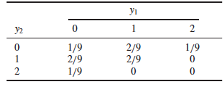
EXAMPLE 5.2 (P227) Consider the random variables Y₁ and Y₂ of Example 5.1 (see the table below). Find F(1.5, 2), F(−1, 2), and F(5, 7).

Slide 17
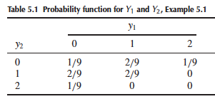
EXAMPLE 5.1 (Page 226) A local supermarket has three checkout counters A, B, C. Two customers (P1 and P2) arrive at the counters at different times when the counters are serving no other customers.
Each customer chooses a counter at random, independently of the other.
Let Y₁ denote the number of customers who choose counter A, and Y₂, the number who select counter B.
Find the joint probability function of Y₁ and Y₂.
Solution: All the different ways of two customers
going to three counters form the sample space of the
experiments, that is,
S = [{A, A}, {A, B}, {A, C},
{B, A}, {B, B}, {B, C},
{C, A}, {C, B}, {C, C}]. A, B, C represent 3 counters
Then we can get the joint distribution of Y₁ and Y₂ as shown in the right table.
17

Slide 18
Group Problem
Consider an experiment which consists of 2 rolls of a fair die. The SS consists of 36 points, each of which will be assigned a probability of 1/36.
If the 2 random variables of which we are interested are x, the number of 3s and y, the number of 5s obtained in the two rolls of the die. Each element in the sample space is assigned two numbers, the first number is the value of x at that point and the second number is the value of y.
1. Draw a diagram for this setup

Slide 19
Group Problem, page 2
To obtain f(x,y) for any pair of values x and y, we have only to add the probabilities of those elements of the SS to which these values are assigned. Proceed in this way to create the joint distribution of the given variables x and y in the table:

Slide 20
Group Problem, page 3
Now, write the marginals of X and Y:
Create some conditional questions:

